Slide 1
Clock Status and Rules
Classroom Session #5

Slide 2
Keys to Enjoyment
1. Transparency
  Admit when you make a mistake
2. Dependability
  Be where you are needed
3. Motivation
  Love the level you are at
4. Communication
  Be clear and up front
5. Empathy
Passionate Folks do ordinary things well
Source: Art Brown
ACC Official

Slide 3
Learning Objectives
At the completion of this section, you will understand
  The Clock
    Periods and Intermissions
      Varsity and Subvarsity
    Major and Minor Clock Stoppers
    Kickoff
    Scrimmage Plays
    End of Half
    Play Clock

Slide 4
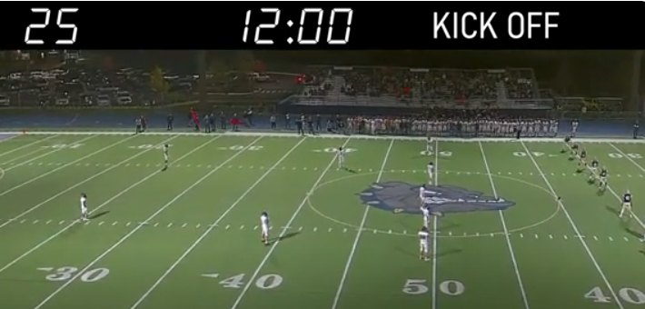
Periods and Intermissions
VARSITY | 12:00 Periods | 15 – 20 minute half
SUBVARSITY | 10:00 Periods | 5 – 10 minute half

Slide 5
Clock Operator Responsibilities
Starting and Stopping the Scoreboard Clock
  Official’s Signals
Put 10 or 12 minutes to start the period
Put the halftime clock up at the end of 2nd Qtr
  Referee will wind, then you start it
Put 3 minutes at the end of halftime in varsity
  Mandatory 3 minute warm up as soon as the clock hits 0:00
Add or subtract time as required

Slide 6
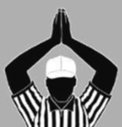
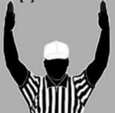
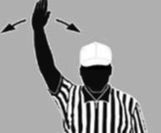

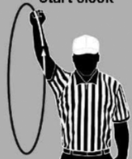
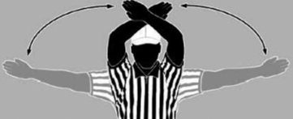
Officials Signals
Stop Clock
  Touchdown
  Incomplete pass
  Time Out
  Safety
  Touchback
  Start Clock ->

Slide 7
Starting the Clock
Officials will start the stopped clock
  After penalty enforcement*
  After an injured player is treated*
  After a ball goes out of bounds*
  Automatically when the ball is snapped
  Legal touch on a Free Kick
Clock operators need to watch carefully whenever the clock is stopped
  Don’t miss the officials starting the clock
    Often a silent signal
* Unless a major clock stopper occurred (see future slides)
Notes:
Discussion why lining up in front of ball
Actions on Illegal substitution
Demonstrate Signal for Down
Demonstrate Signal for 2 stakes

Slide 8
Major and Minor Clock Stoppers
The clock runs, even while the ball is dead, unless officials stop the clock(whistle and signal)
  Major clock stoppers
    The clock will start on the snap
  Minor clock stoppers
    The clock will start on the referee’s signal
Officials MUST know the major clock stoppers!
Clock operators should only add down and distance while the clock is running
  Don’t miss a signal
Notes:
Discussion why lining up in front of ball
Actions on Illegal substitution
Demonstrate Signal for Down
Demonstrate Signal for 2 stakes

Slide 9
Major Clock Stoppers
  Ball goes out of bounds
    Unless it is a forward fumble out of bounds
  Team B or R is awarded a new series
  Either team gets a new series after a legal kick
  An apparent touchdown, safety, or touchback
    Even if a penalty cancels it
  Incomplete forward pass
  Period ends
  Delay of game penalty is accepted
  Fair Catch
  Either team is illegally wasting time
Memorize
These!
Notes:
Discussion why lining up in front of ball
Actions on Illegal substitution
Demonstrate Signal for Down
Demonstrate Signal for 2 stakes

Slide 10
Minor Clock Stoppers
Any other reason the clock was stopped
  Official’s time out
  Forward fumble out of bounds
  First down for Team A
  Measurement
  Turnover when team A ends up with the ball
  Inadvertent whistle
Notes:
Discussion why lining up in front of ball
Actions on Illegal substitution
Demonstrate Signal for Down
Demonstrate Signal for 2 stakes

Slide 11
Untimed Downs
The clock doesn’t run, and stays where it is
  The Try after a Touchdown
  Accepted Penalty when time runs out on the play
    Unless the penalty carries a loss of down
  Overtime
Notes:
Discussion why lining up in front of ball
Actions on Illegal substitution
Demonstrate Signal for Down
Demonstrate Signal for 2 stakes

Slide 12
Clock on Kick Plays
Free Kick, clock starts ONLY when the kick is legally touched
  Officials wind when the kick is legally touched
  If K touches before the kick has gone 10 yards, the clock DOES NOT start
Punt or Field Goal
  Just like any other scrimmage play
  The clock stops at the end of the play if the ball was kicked and it got past the line of scrimmage
Notes:
Discuss what defines an DL being on the LOS
Discuss LB and blitz reads
Talk to DBs who need help being behind their LOS

Slide 13
Scrimmage Plays
The clock will usually be running
  Always running during playing action
  Only stopped between plays if there was a major clock stopper
Starting on the Snap
  The clock starts on the LEGAL snap
    A Dead ball foul preventing the snap will not run off any time
    After enforcement, the clock will be back the way it was before the foul (running or stopped)
Clock stoppers at the end of plays (see list)
Notes:
Discuss what movement of the ball the center can do legally and when
Discuss OL drawing defense offsides
Quick explanation on what formation keys are, defer to future discussion

Slide 14
CIAC Running Clock Rule
High School
  Score difference of 42 in the 3rd or 35 in the 4th Qtr
    Runs continuously
      Incomplete pass, first down, penalty enforcement, out of bounds
    Clock stops
      End of period
      Scores
      Try play is still untimed
      Team Timeout
      Official’s timeout or Injury
Youth football has a similar rule

Slide 15
Play Clock – Varsity football
40 seconds
  40 seconds after most plays
  No whistle for the ready for play from the referee
    1st down
    Run or pass play
    Complete or incomplete, in or out of bounds
  After a foul or injury by the defense

Slide 16
Play Clock – Varsity football
25 seconds
  Whistle for the ready for play from the referee
    A score occurs, prior to the Try
    Starting a period
    Charged Time out
    Measurement
    Inadvertent whistle
    Free Kick
    The play after a change in possession
  After a foul or injury by the offense

Slide 17
Pregame duties
Clock operator
  In locker room with crew at designated time
  In Box no later than 30 minutes before the game
  Primary on the clock, secondary – other scoreboard duties
  Have a watch with a countdown timer
  Keep record of timeouts and UNS fouls
  Have the crew radio and ear piece

